Slide 1
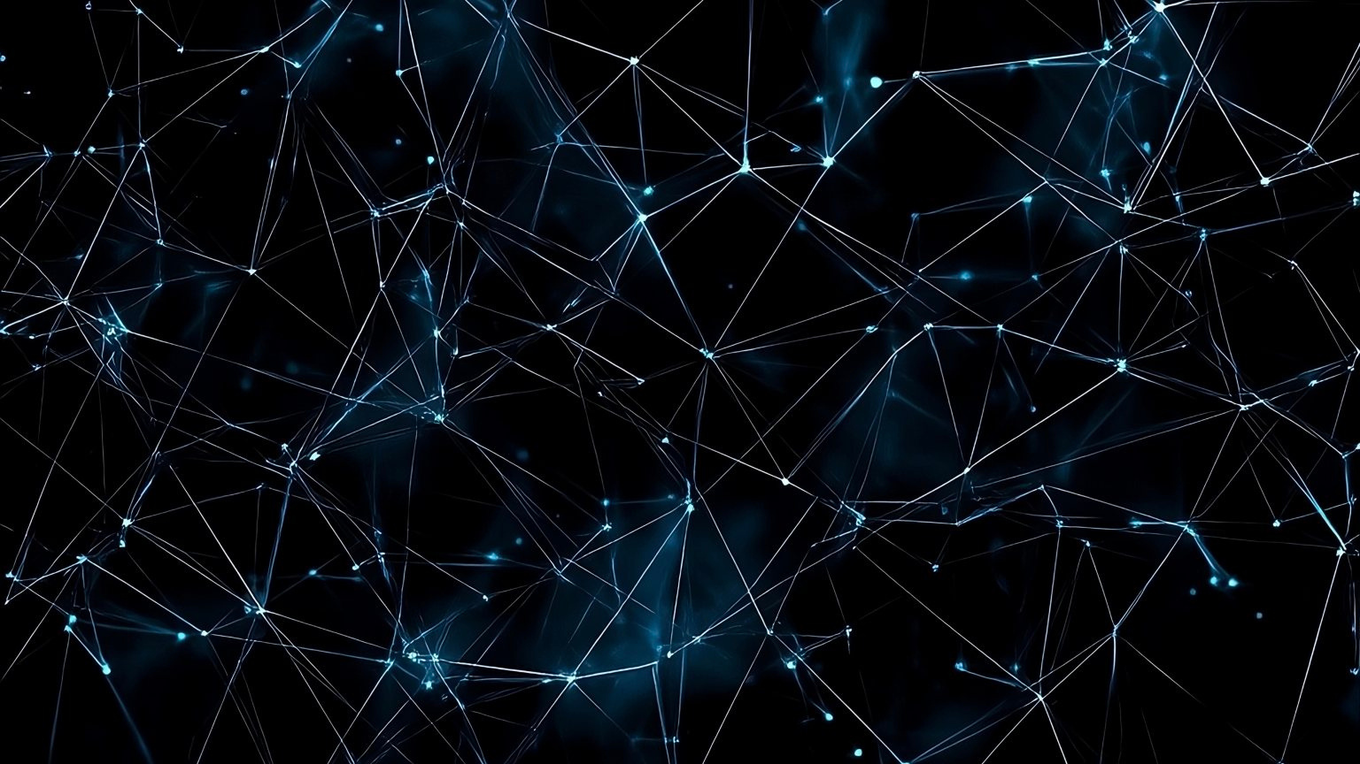



Agentic RAG Chatbot for Multi-Format Document QA
Author: Pi
Date: 2025.07.06
Notes:
1

Slide 2

CONTENTS
1. Title Slide
2. Agent-based Architecture with MCP Integration
3. System Flow Diagram (with Message Passing)
4. Code File Architecture & Tech Stack
5. UI Screenshots, Challenges & Future Scope
Notes:
2

Slide 3


01
Title Slide
Notes:
3

Slide 4


Title Slide
1
Title
2
Subtitle
Agentic RAG Chatbot for Multi-Format Document QA
Leveraging Model Context Protocol (MCP) for Enhanced Information Retrieval
3
Your Name
4
Date
[Your Name Here]
[Current Date]
Notes:
4

Slide 5


02
Agent-based Architecture with MCP Integration
Notes:
5

Slide 6


Our Agentic RAG Architecture
Modular Design: System composed of specialized, autonomous AI agents.
Enhanced Capabilities: Each agent focuses on a specific task, improving scalability and maintainability.
Notes:
6

Slide 7

Our Agentic RAG Architecture
Key Agents
Coordinator Agent
Ingestion Agent
Orchestrates workflow, routes requests, manages conversation flow.
Parses and preprocesses diverse document formats (PDF, PPTX, CSV, DOCX, TXT/MD).
Retrieval Agent
LLM Response Agent
Manages vector store (FAISS), generates embeddings, performs semantic search for relevant content.
Constructs prompts, interacts with Google Gemini 2.0 Flash via API, and generates final answers.
Notes:
7

Slide 8


Model Context Protocol (MCP): The Communication Backbone
1
Standardized Messaging: Agents communicate using structured JSON-like objects.
2
Clear Context Passing: Messages define sender, receiver, type, trace_id, and payload.
3
In-Memory Implementation: For this project, MCP is implemented via an in-memory message bus for efficient inter-agent communication.
Notes:
8

Slide 9

03
System Flow Diagram (with Message Passing)
Notes:
9

Slide 10

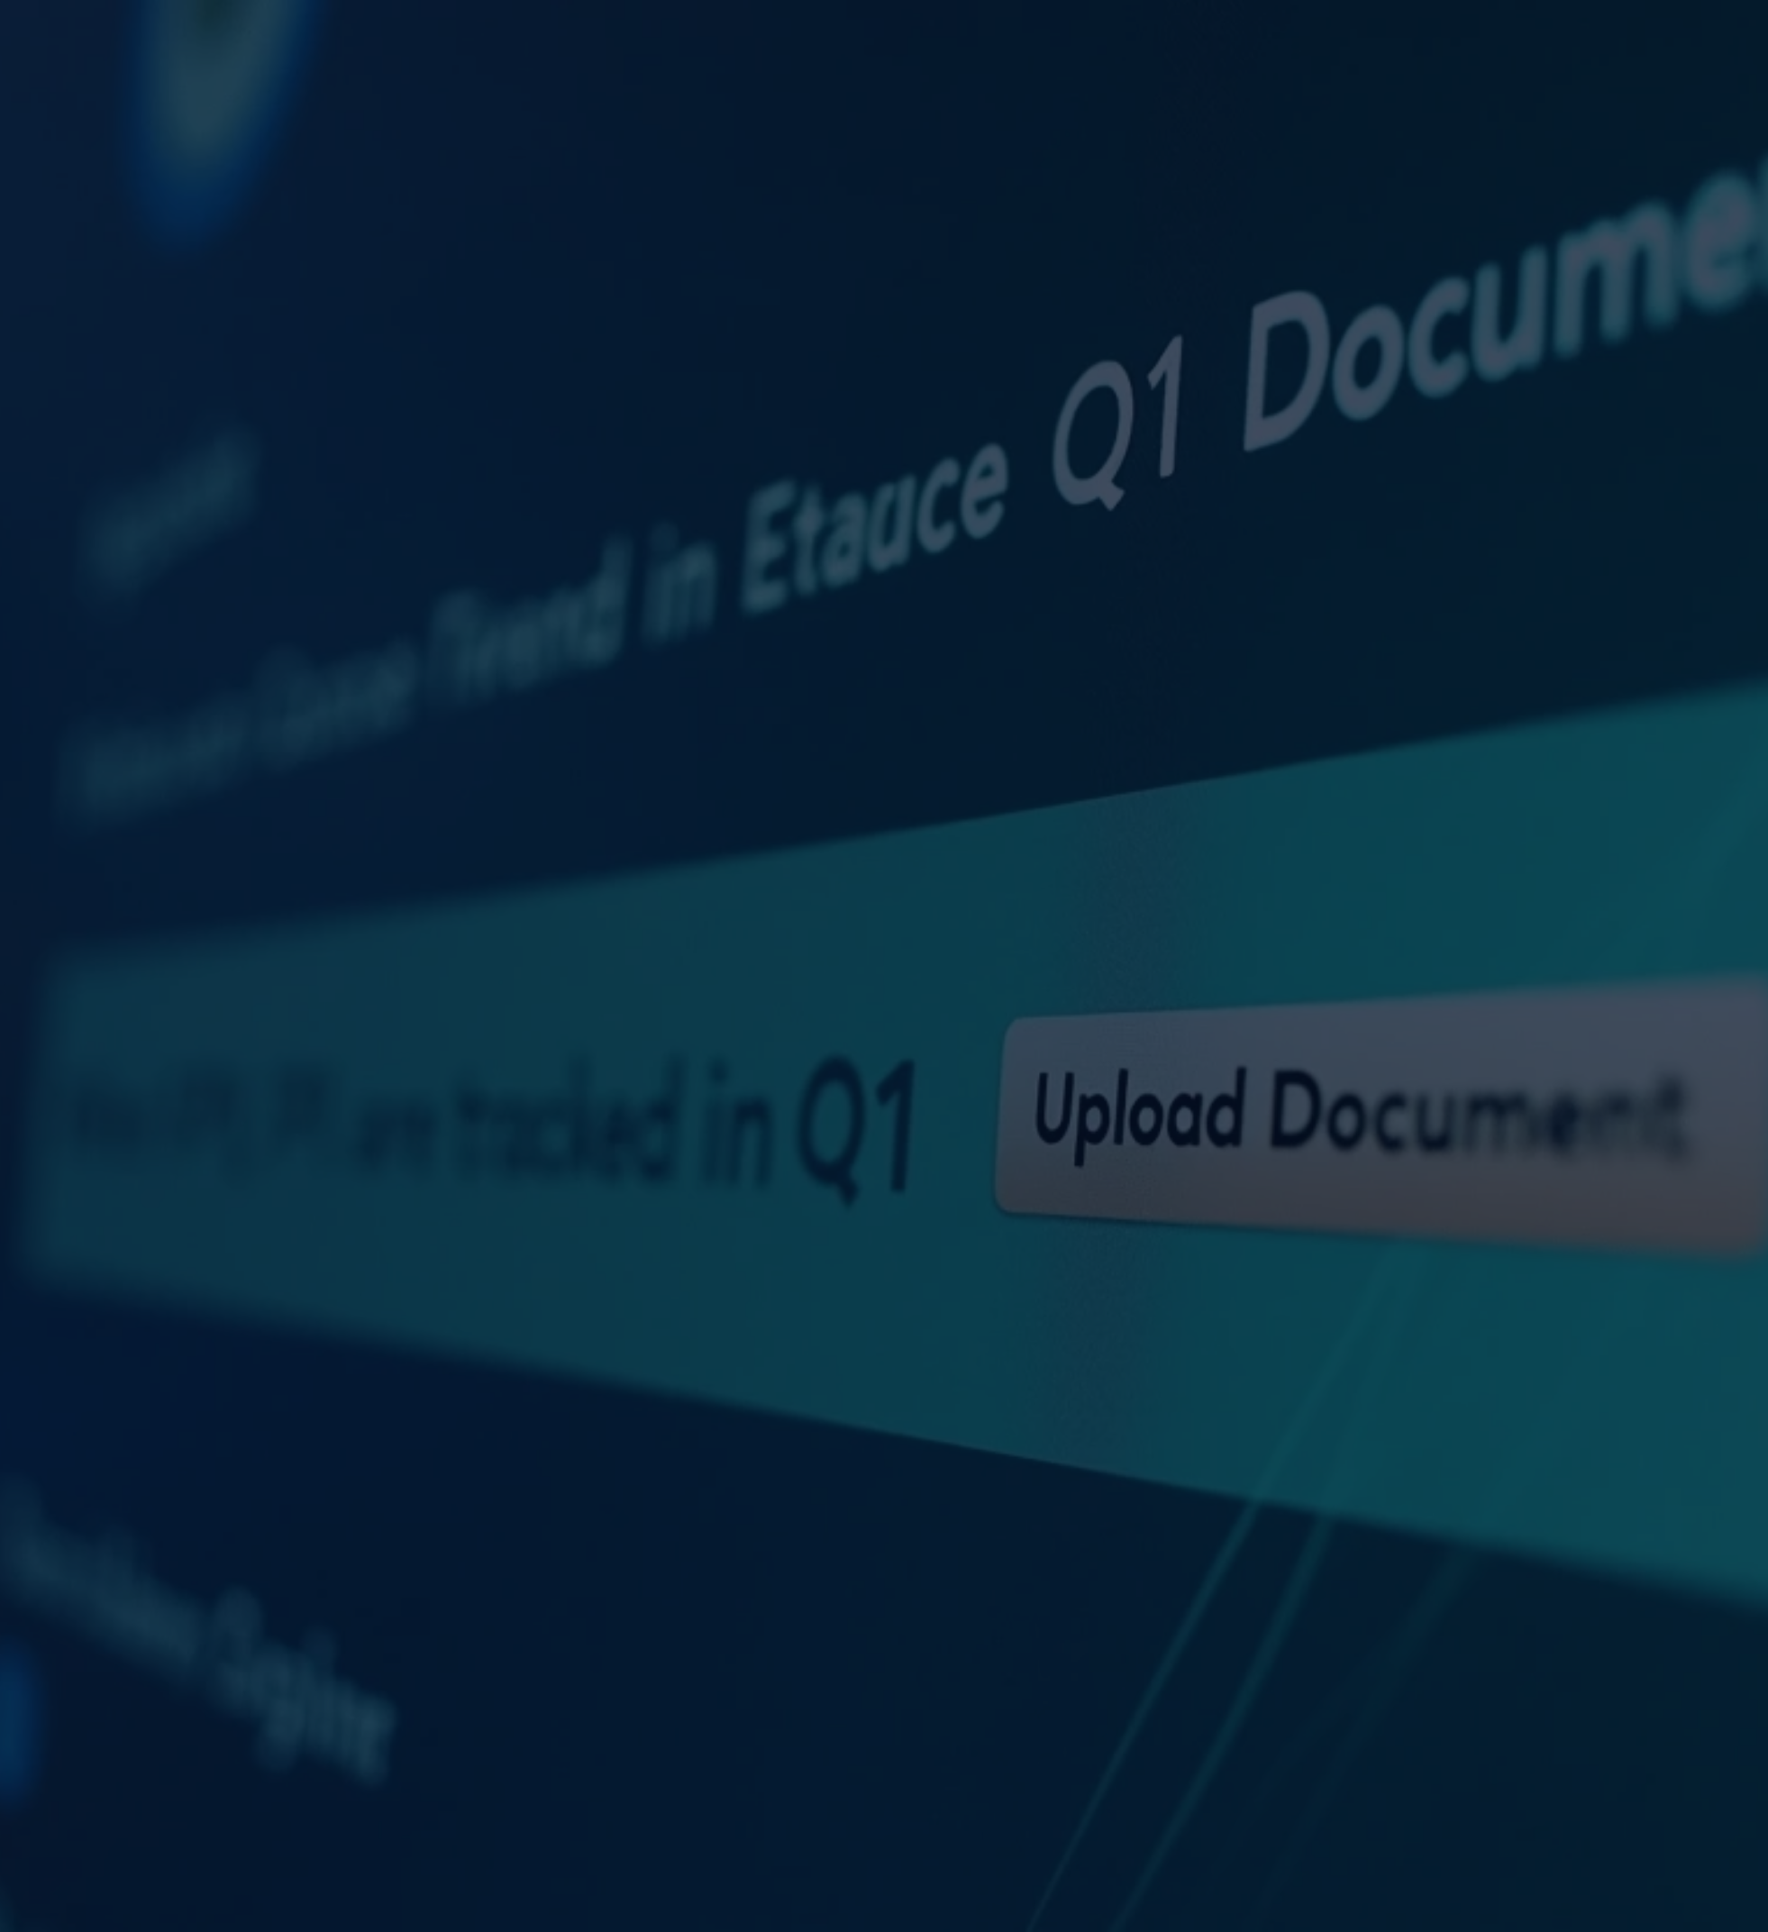


How It Works: A Query Flow Example
1
2
3
4
5
User Interaction (UI)
Coordinator Agent
Ingestion Agent (for uploads)
Retrieval Agent
LLM Response Agent
• Action: Receives UI request, initiates a trace_id.
• Action (for uploads): Chunks text, embeds, adds to FAISS.
• Action: User uploads document or asks a question ("What KPIs were tracked in Q1?").
• Action: Parses document into raw text.
• Action: Constructs LLM prompt with query and context, calls Google Gemini 2.0 Flash via API, generates answer.
• Message (Coordinator -> Ingestion/Retrieval):
• Message (Ingestion -> Retrieval): INGESTION_COMPLETE (payload: raw_text, source_metadata)
• Action (for queries): Embeds query, searches FAISS for top_chunks.
• Message (UI -> Coordinator): UI_UPLOAD_REQUEST / UI_QUERY_REQUEST
• For Upload: UPLOAD_DOCUMENT (to Ingestion Agent)
• Message (Retrieval -> LLMResponse): RETRIEVAL_RESULT (payload: query, retrieved_context, source_metadata)
• Message (LLMResponse -> Coordinator): FINAL_RESPONSE (payload: answer, source_chunks, source_metadata, original_query)
• For Query: QUERY_REQUEST (to Retrieval Agent)
6
7
Coordinator Agent
User Interface (UI)
• Action: Receives final answer, updates conversation state.
• Displays the answer to the user.
• Presents the source_chunks in an expandable section for transparency.
• Output (Coordinator -> UI Callback): FINAL_RESPONSE (displayed to user)
Notes:
10

Slide 11

04
Code File Architecture & Tech Stack
Notes:
11

Slide 12


Project Structure & Core Technologies
Code File Architecture
rag_chatbot/ ├── agents/ /# Specialized AI agents │ ├── base_agent.py │ ├── coordinator_agent.py │ ├── ingestion_agent.py │ ├── llm_response_agent.py │ └── retrieval_agent.py ├── utils/ /# Helper functions & MCP │ ├── document_parser.py │ ├── mcp.py │ └── vector_store_manager.py ├── config.py /# Configuration settings (API keys, model names) ├── main.py /# Streamlit UI & application entry point ├── README.md /# Project documentation └── requirements.txt /# Python dependencies
1
Python: Primary programming language.
2
Streamlit: Intuitive framework for the web-based Chatbot UI.
3
Google Gemini 2.0 Flash API: For Large Language Model (LLM) capabilities.
4
requests: For making HTTP API calls to the Google Gemini API.
5
LangChain: Orchestration framework for LLM applications (used for chunking, embeddings, prompt management).
6
RecursiveCharacterTextSplitter (text chunking)
7
SentenceTransformerEmbeddings (embedding generation)
8
FAISS (vector database for retrieval)
9
sentence-transformers: Provides pre-trained models for creating embeddings (all-MiniLM-L6-v2).
10
Document Parsers: pypdf, python-docx, python-pptx, pandas (for CSV).
Notes:
12

Slide 13
05
UI Screenshots, Challenges & Future Scope
Notes:
13

Slide 14

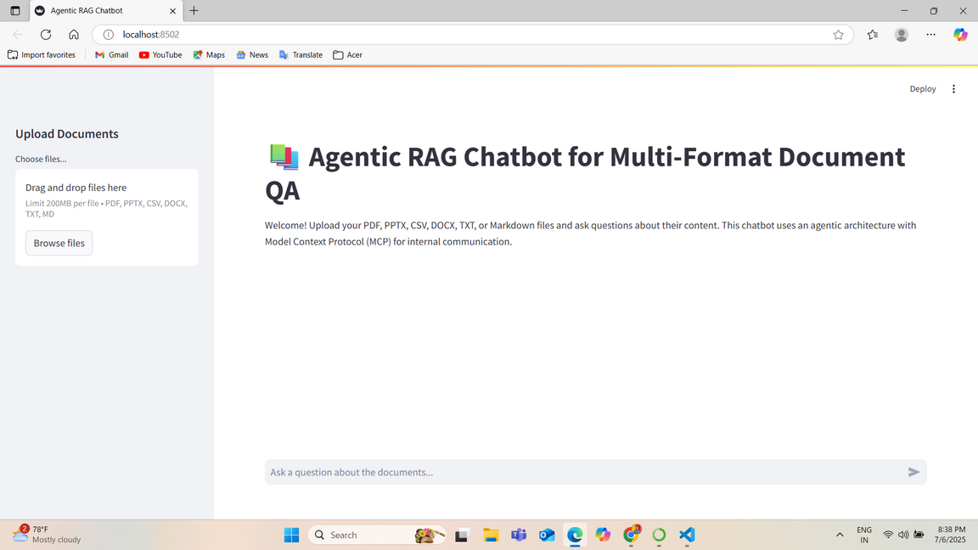
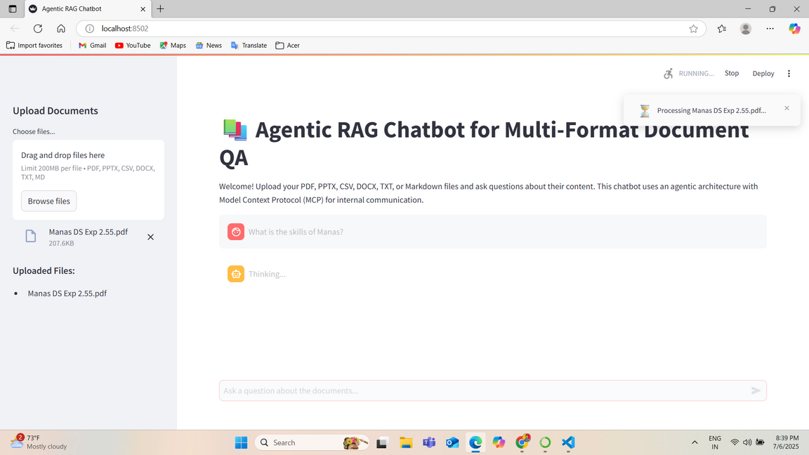
Demonstration, Development Insights & Future Vision
User Interface (UI) Screenshots
Notes:
14

Slide 15

Demonstration, Development Insights & Future Vision
Challenges Faced
Streamlit's Synchronous Nature & UI Updates: Implementing responsive UI updates with Streamlit's execution model and asynchronous-like agent communication.
Temporary File Management: Handling uploaded files by saving them to a temporary disk location for agent access.
LLM API Key & Integration: Ensuring correct API key configuration for Google Gemini and robust direct API call handling.
Notes:
15

Slide 16

Demonstration, Development Insights & Future Vision
Future Scope / Improvements
1
Persistent Vector Store: Integrate with cloud-based vector databases (e.g., Pinecone, Weaviate).
2
Asynchronous Message Bus: Replace in-memory MessageBus with a true asynchronous system (e.g., Celery).
3
Advanced Document Processing: Incorporate OCR, enhanced table/figure handling.
4
Multi-Modal RAG: Extend to process images, audio, or video content.
5
User Authentication: Implement user logins for private data management.
Notes:
16

Slide 17

Thank You
Notes:
17

